Slide 1
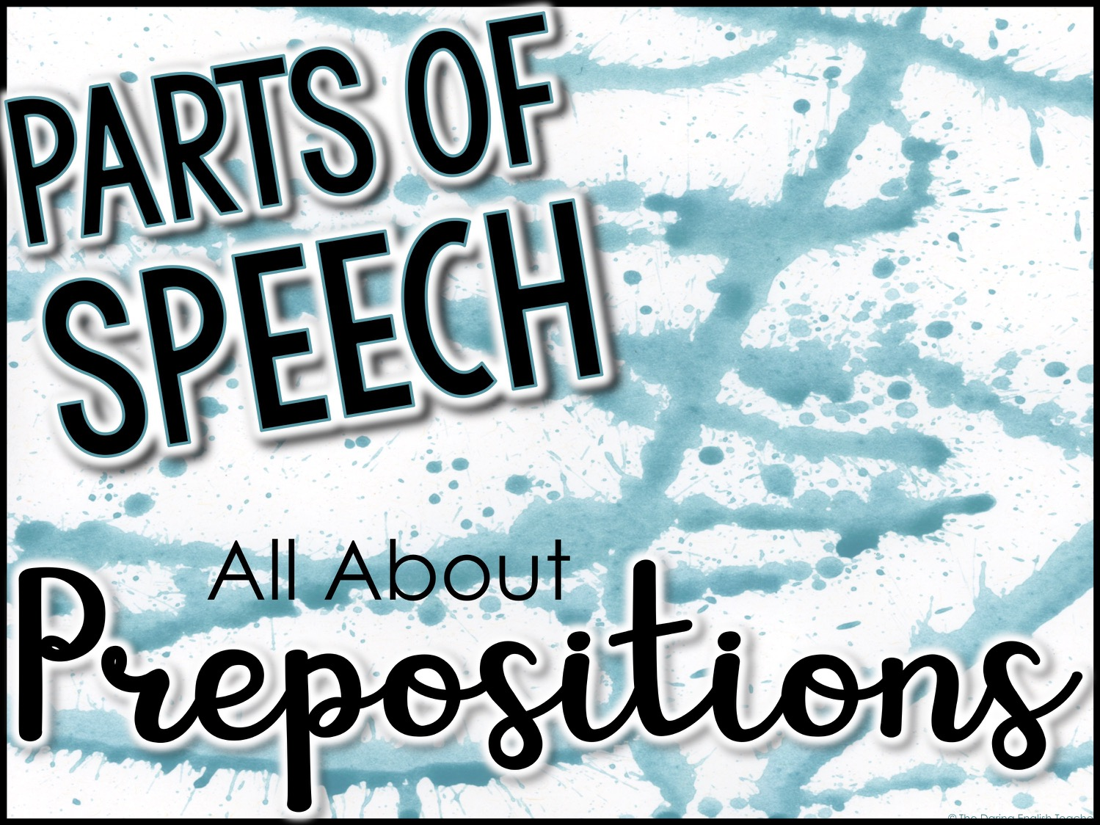
Parts of Speech
All About
Prepositions

Slide 2
Prepositions
A preposition is a word that describes or indicates the location or direction of objects in a sentence.
There are several kinds of prepositions:
Prepositions of time
Prepositions of place
Prepositions of movement

Slide 3
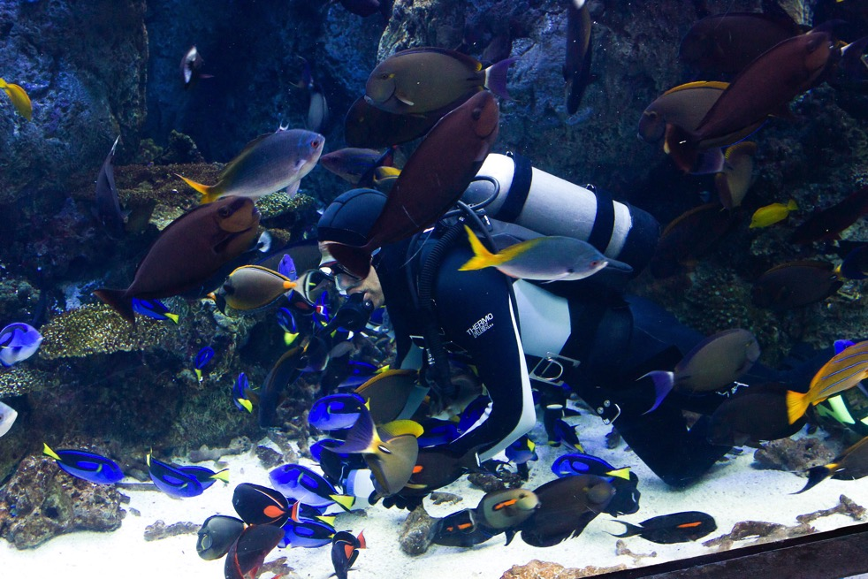
Prepositions
Examples:
The diver swam in a large fish tank.
The preposition in indicates the diver’s location.
The preposition in indicates the diver’s location.

Slide 4
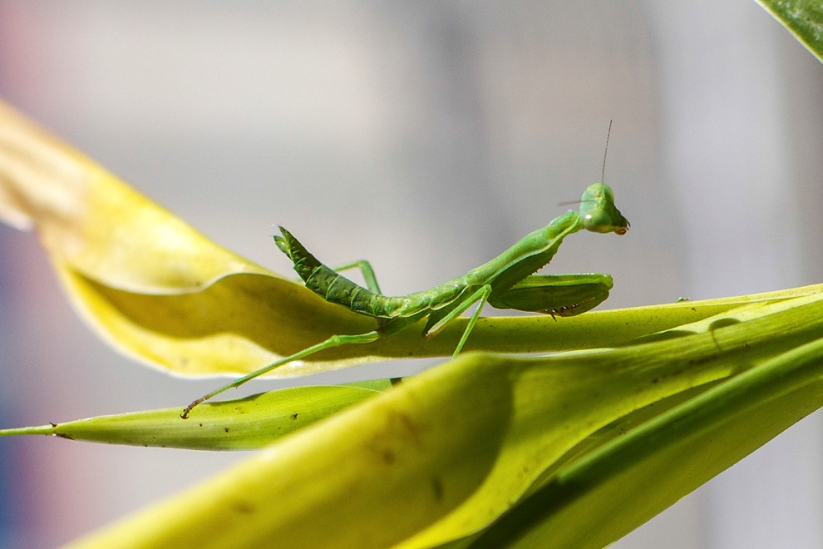
Prepositions
Examples:
The praying mantis sat upon a leaf.
The preposition upon indicates what the mantis is on.

Slide 5
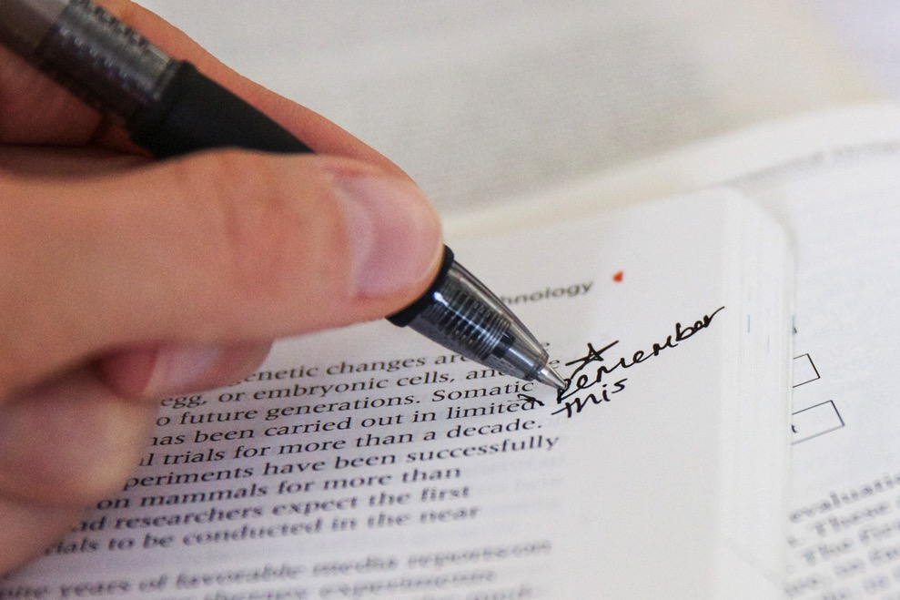
Prepositions
Examples:
A person wrote on a page in the book.
The prepositions on and in indicate where the writing is.

Slide 6
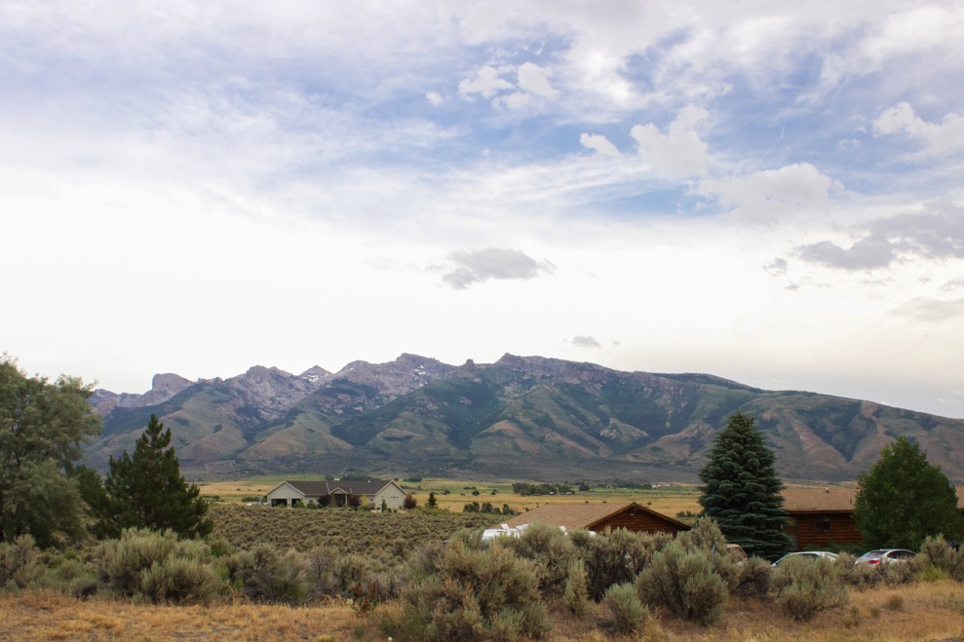
Prepositions
Examples:
Clouds drifted over the mountains.
The preposition over indicates the movement of the clouds.

Slide 7
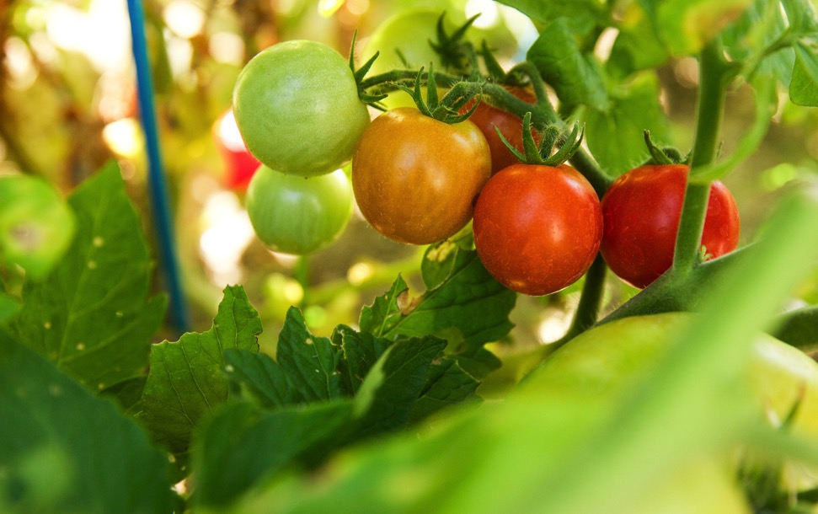
Prepositions
Examples:
An orange tomato hung between the green and red ones.
The preposition between indicates the location of the orange tomato.

Slide 8
Prepositions
Commonly Used Prepositions
of | on | as | over | without
in | at | into | between | before
to | from | like | out | under
for | by | through | against | around
with | about | after | during | among

Slide 9
Prepositions of Time
Prepositions can be used to show time.
Examples:
at, in, on
The essay is due in the morning.
We are eating dinner at 6 p.m.

Slide 10
Prepositions of Time
More examples:
The plane will arrive at 3 p.m.
I like to go for a run in the morning.
Our homework is due on Monday.

Slide 11
Prepositions of Place
Prepositions can be used to show place or position.
Examples:
at, on, in
She sat on the chair.
The children are at the zoo.

Slide 12
Prepositions of Place
More examples:
My friends live in the city limits.
We live at 1234 Main Street.
Our school is on Fifth Street.

Slide 13
Prepositions of Movement
Prepositions can be used to show movement.
Examples:
to, toward, through, across, over, under
The man ran through the finish line tape.
Five dogs ran across the meadow.

Slide 14
Prepositions of Movement
More examples:
The cat walked toward the mouse.
A fish swam under the coral.
The person drove to the store.

Slide 15
Prepositions
The easiest way to determine if a word is a preposition is to imagine two objects and their locations.
Any direction or position between a cloud and an airplane is a preposition.

Slide 16
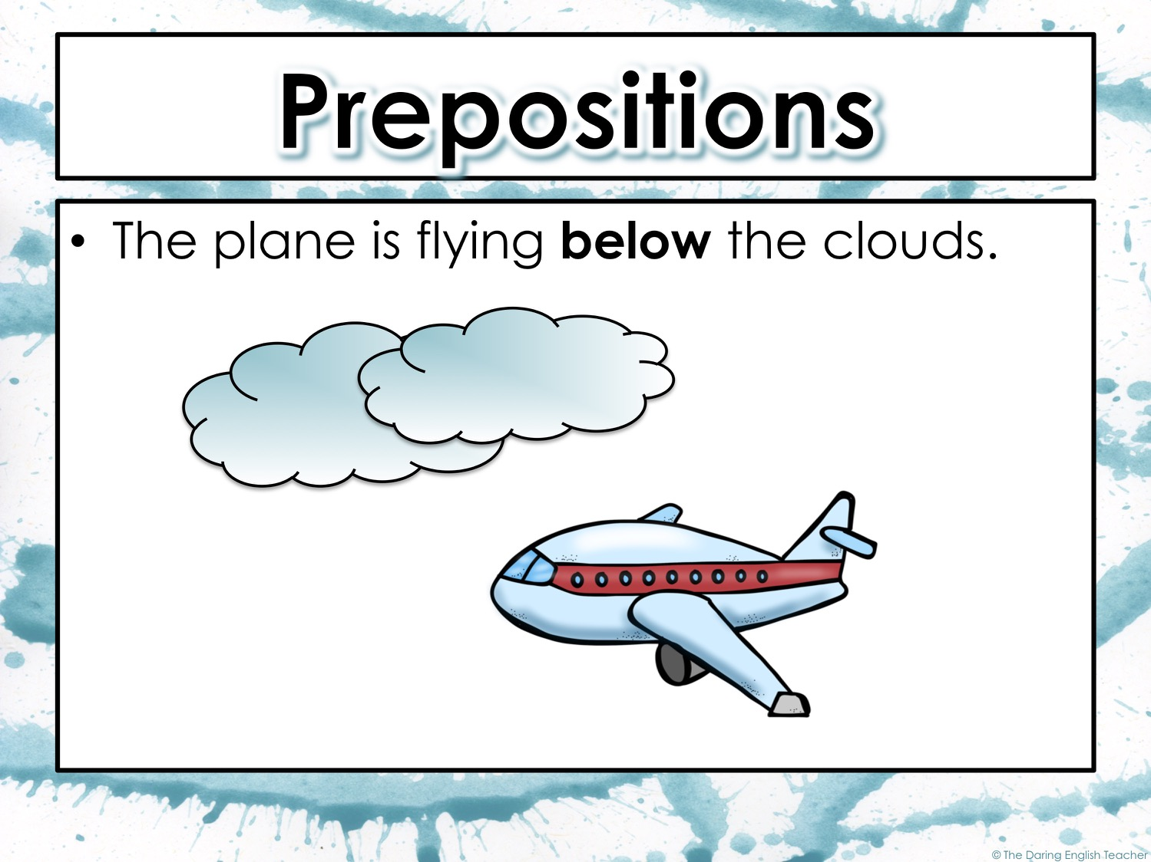

Slide 17
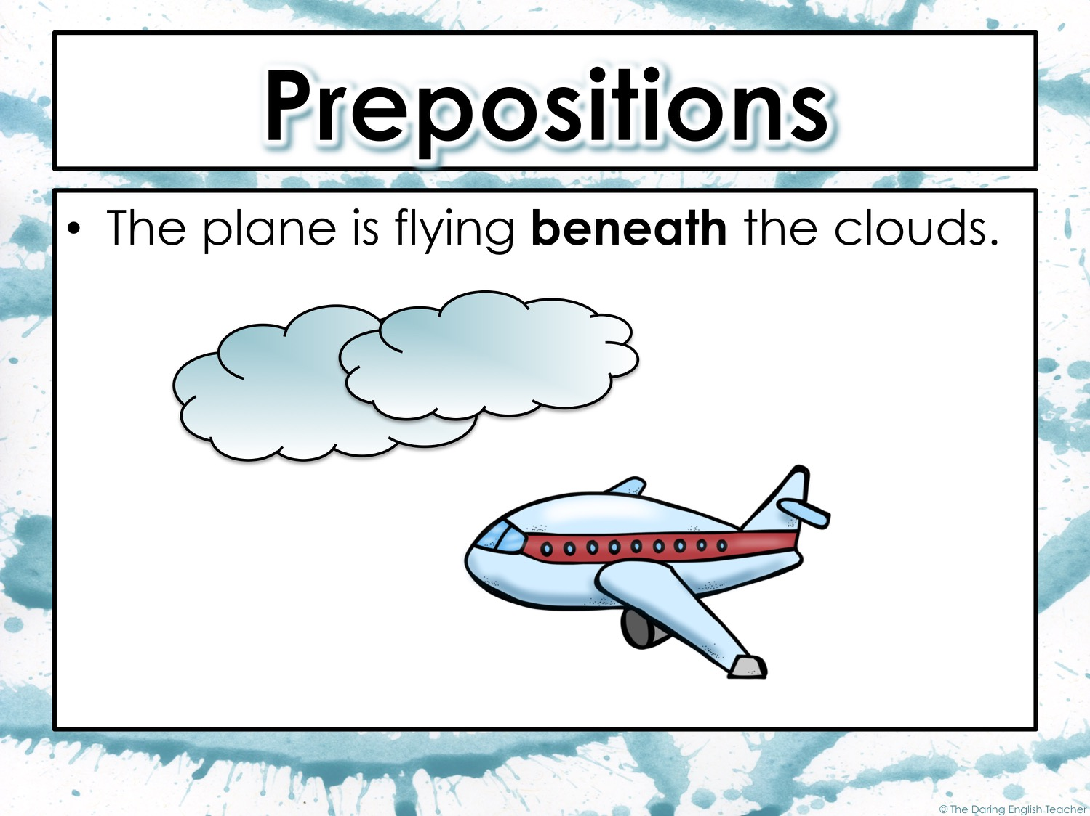

Slide 18
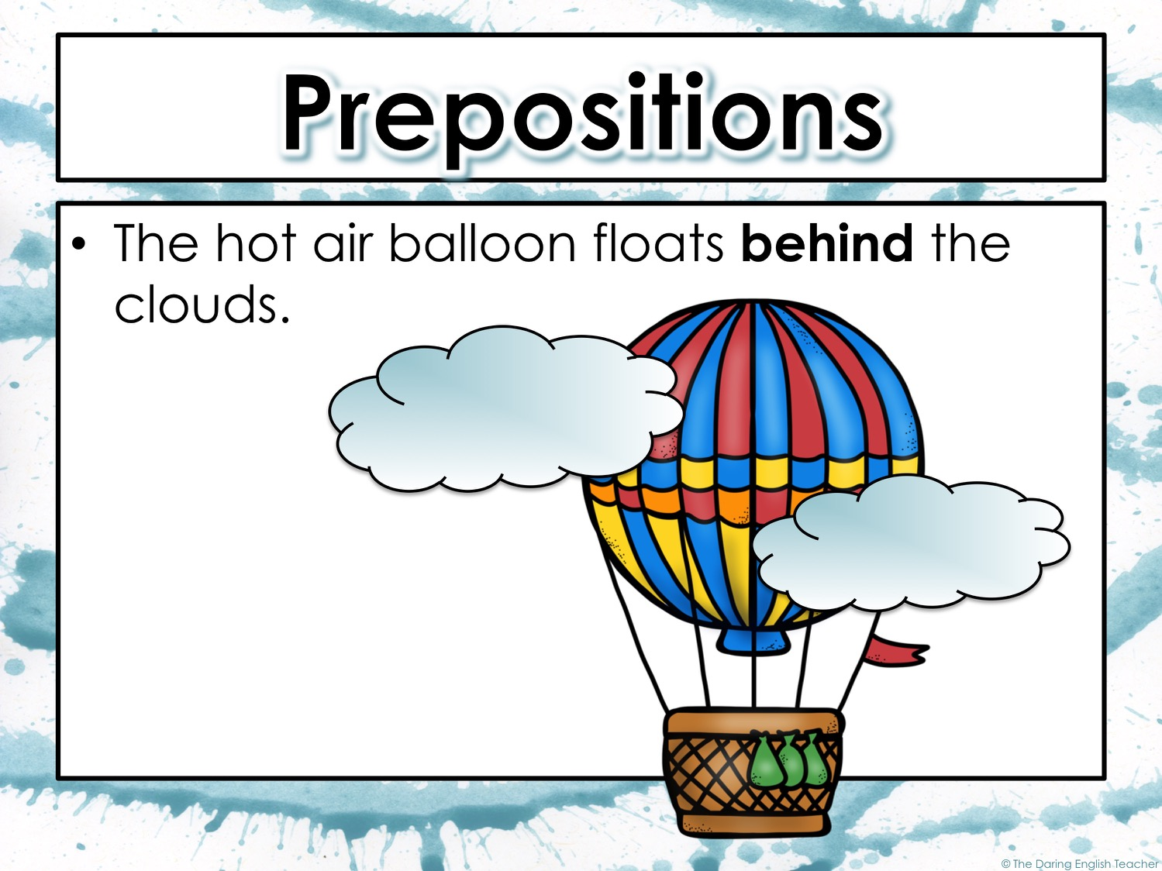

Slide 19
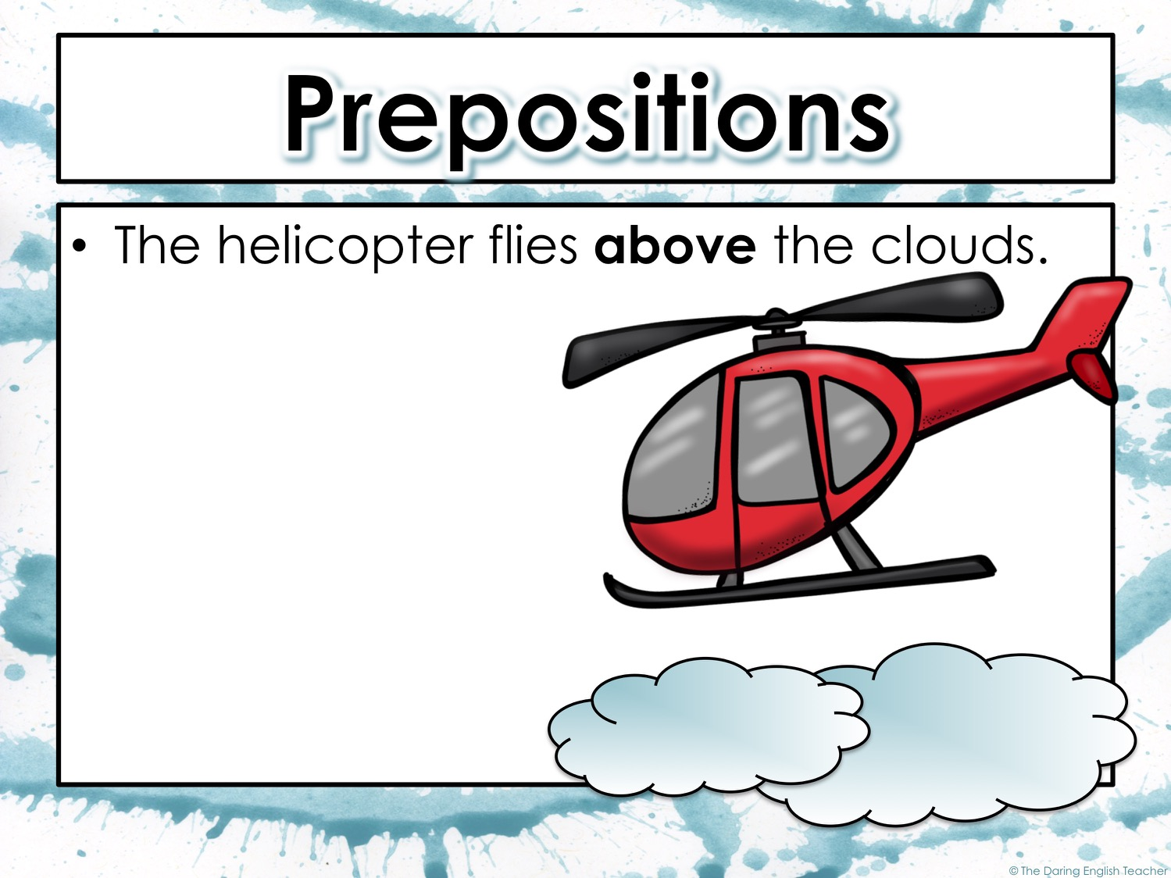

Slide 20
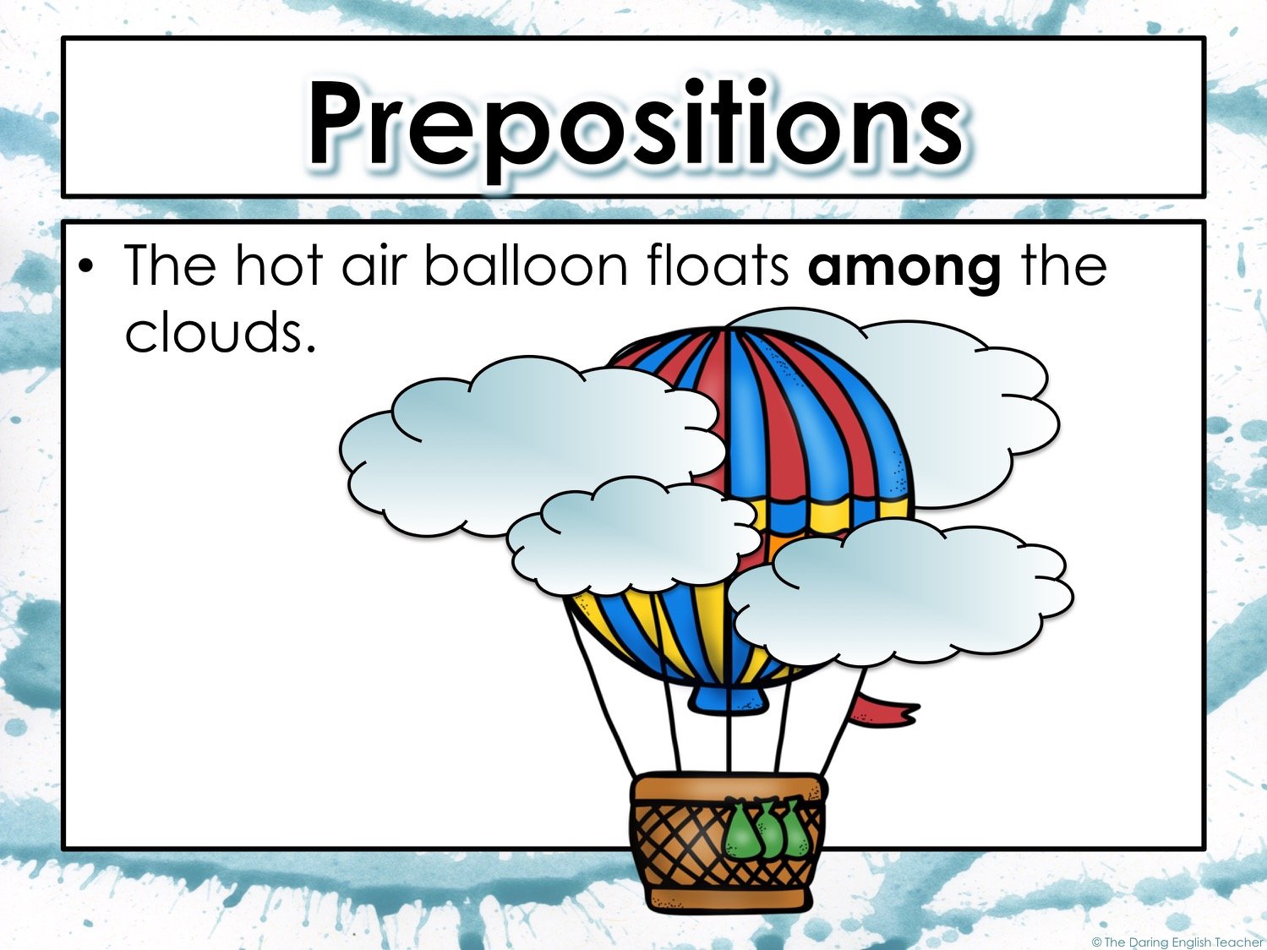

Slide 21
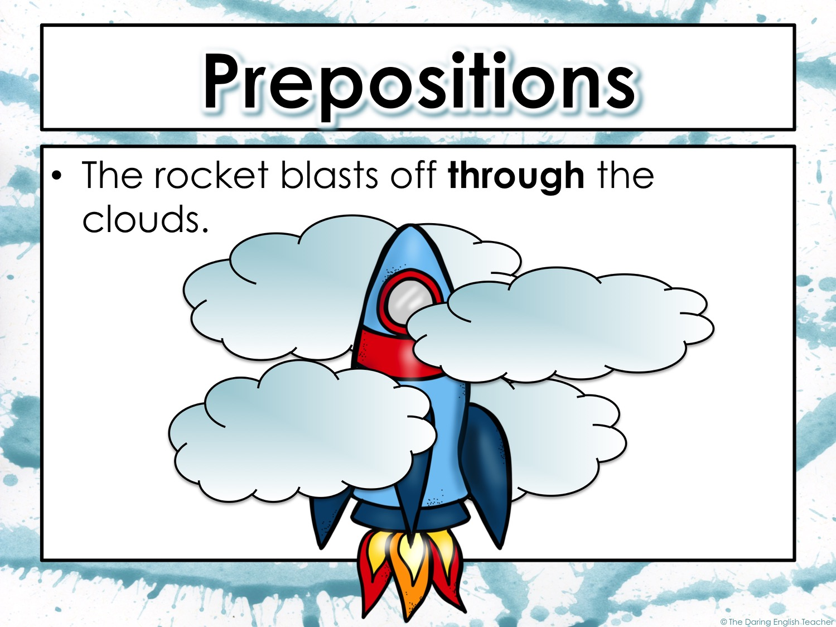

Slide 22
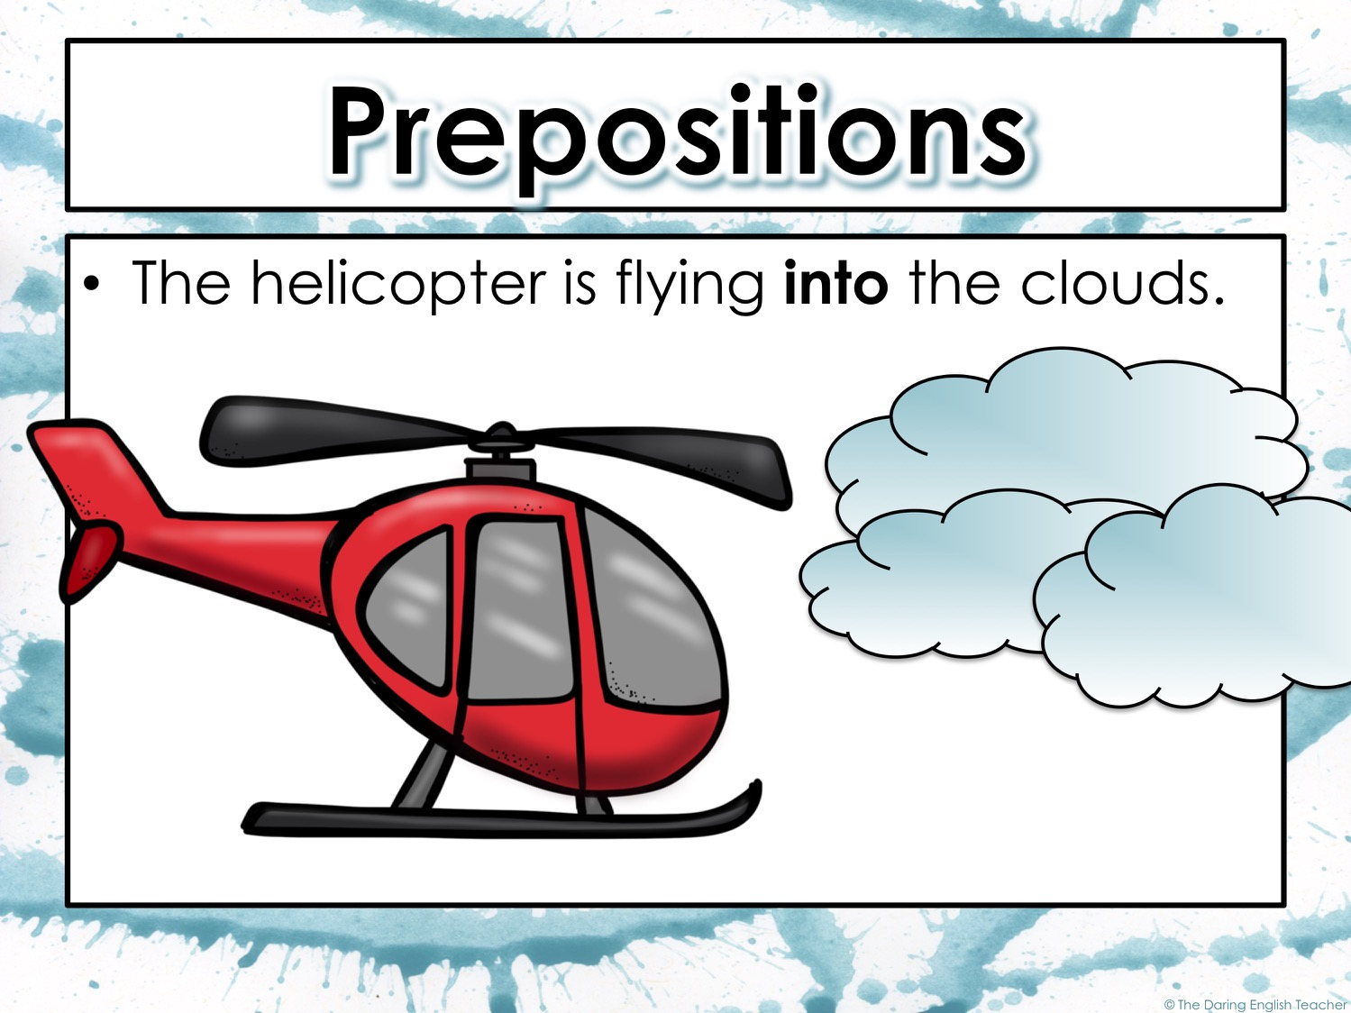

Slide 23
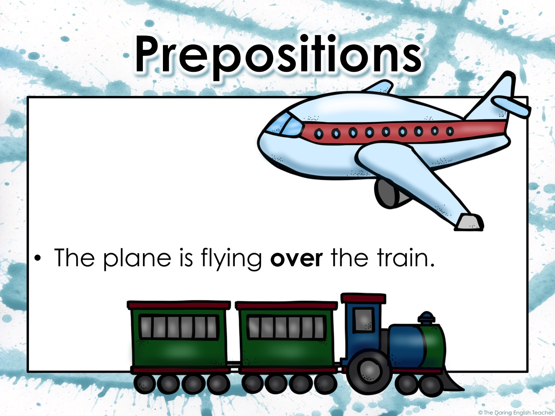

Slide 24
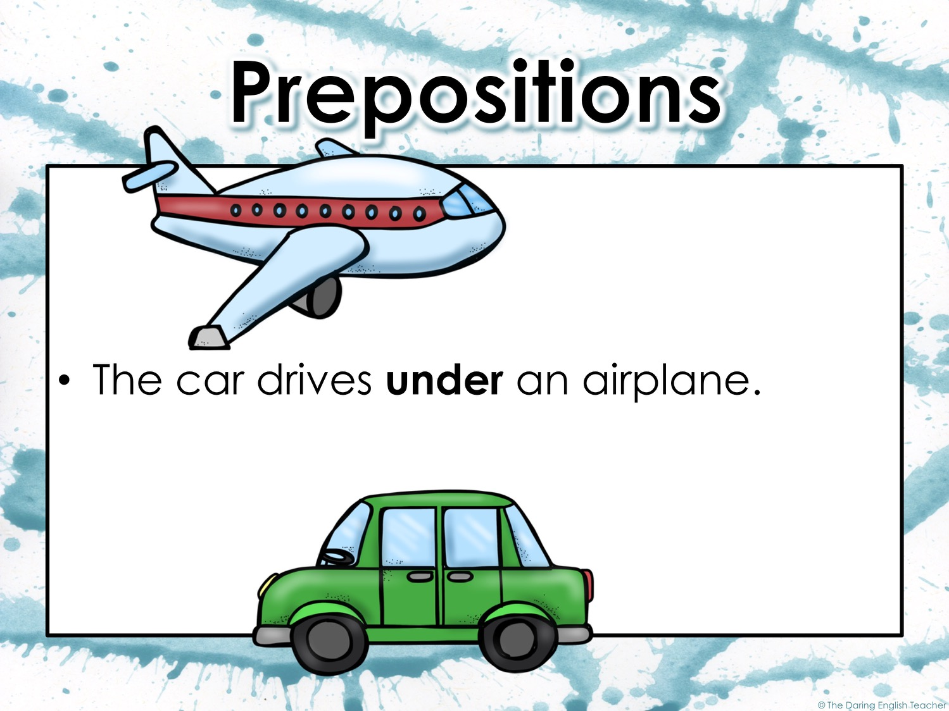

Slide 25
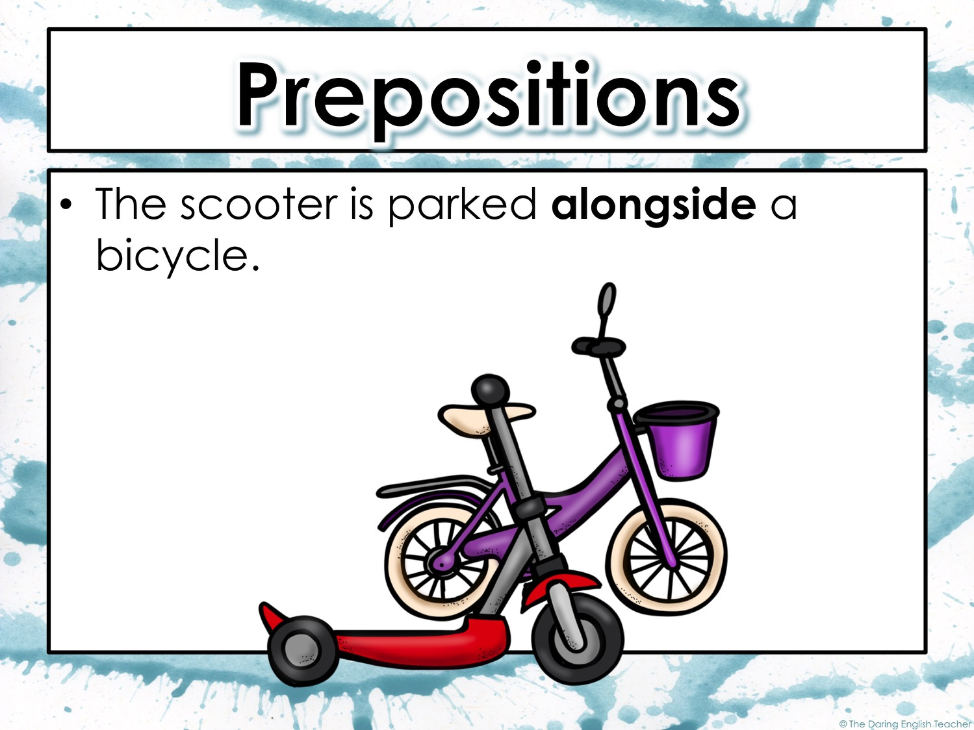

Slide 26
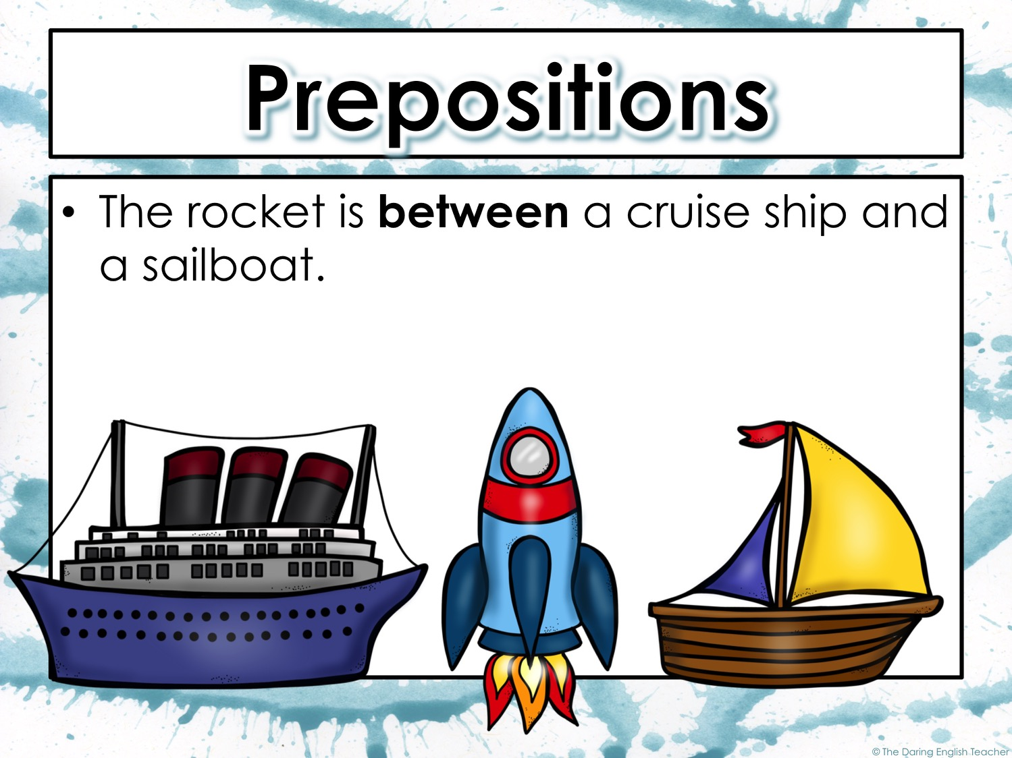

Slide 27
Prepositions
A very common grammatical mistake that people make is using the incorrect preposition in a sentence.

Slide 28
Prepositions
What is the correct preposition.
Place the dog________ the crate.
A. in
B. on
in
Use the preposition on when describing something on the surface. Use in when describing something inside or contained in an object

Slide 29
Prepositions
What is the correct preposition.
Cars drive ________ the street.
A. in
B. on
on
Use the preposition on when describing something on the surface. Use in when describing something inside or contained in an object

Slide 30
Prepositions
What is the correct preposition.
A creek runs ________ the forest.
A. across
B. through
through
Use the preposition through when describing movement in a three dimensional space.

Slide 31
Prepositions
What is the correct preposition.
She arrived ________ the store.
A. at
B. to
at
Use the preposition at to tell where an object is. Use to to describe another location.

Slide 32
Prepositions
What is the correct preposition.
Then she went ________ the bank.
A. at
B. to
to
Use the preposition at to tell where an object is. Use to to describe another location.

Slide 33
Prepositions
What is the correct preposition.
Sam and Carla have been together ________ freshman year.
A. for
B. since
since
Use the preposition since to refer to a specific period. Use for to refer to time.

Slide 34
Prepositions
What is the correct preposition.
I have played soccer ________ I was five-years-old.
A. for
B. since
since
Use the preposition since to refer to a specific period. Use for to refer to time.

Slide 35
Prepositions
What is the correct preposition.
They lived in Italy ________ three years.
A. for
B. since
for
Use the preposition since to refer to a specific period. Use for to refer to time.

Slide 36
Prepositions
What is the correct preposition.
We live ________ Mulberry Street.
A. at
B. on
on
Use the preposition on when referring to a street or road. Use at for a specific address.

Slide 37
Prepositions
What is the correct preposition.
We live ________ 7358 Mulberry Street.
A. at
B. on
at
Use the preposition on when referring to a street or road. Use at for a specific address.

Slide 38
Prepositions
What is the correct preposition.
He caught the raccoon________ setting a trap.
A. by
B. with
by
Use the preposition by when referring to an action. Use with when referring to a tool.

Slide 39
Prepositions
What is the correct preposition.
He caught the raccoon________ a trap.
A. by
B. with
with
Use the preposition by when referring to an action. Use with when referring to a tool.

Slide 40
Objects of Prepositions
Every preposition has an object. The object is a noun that the preposition refers to.
The preposition and its object make up a prepositional phrase.
Example:
I live in a condo.
In is the preposition. Condo is the object.
in a condo is the prepositional phrase.

Slide 41
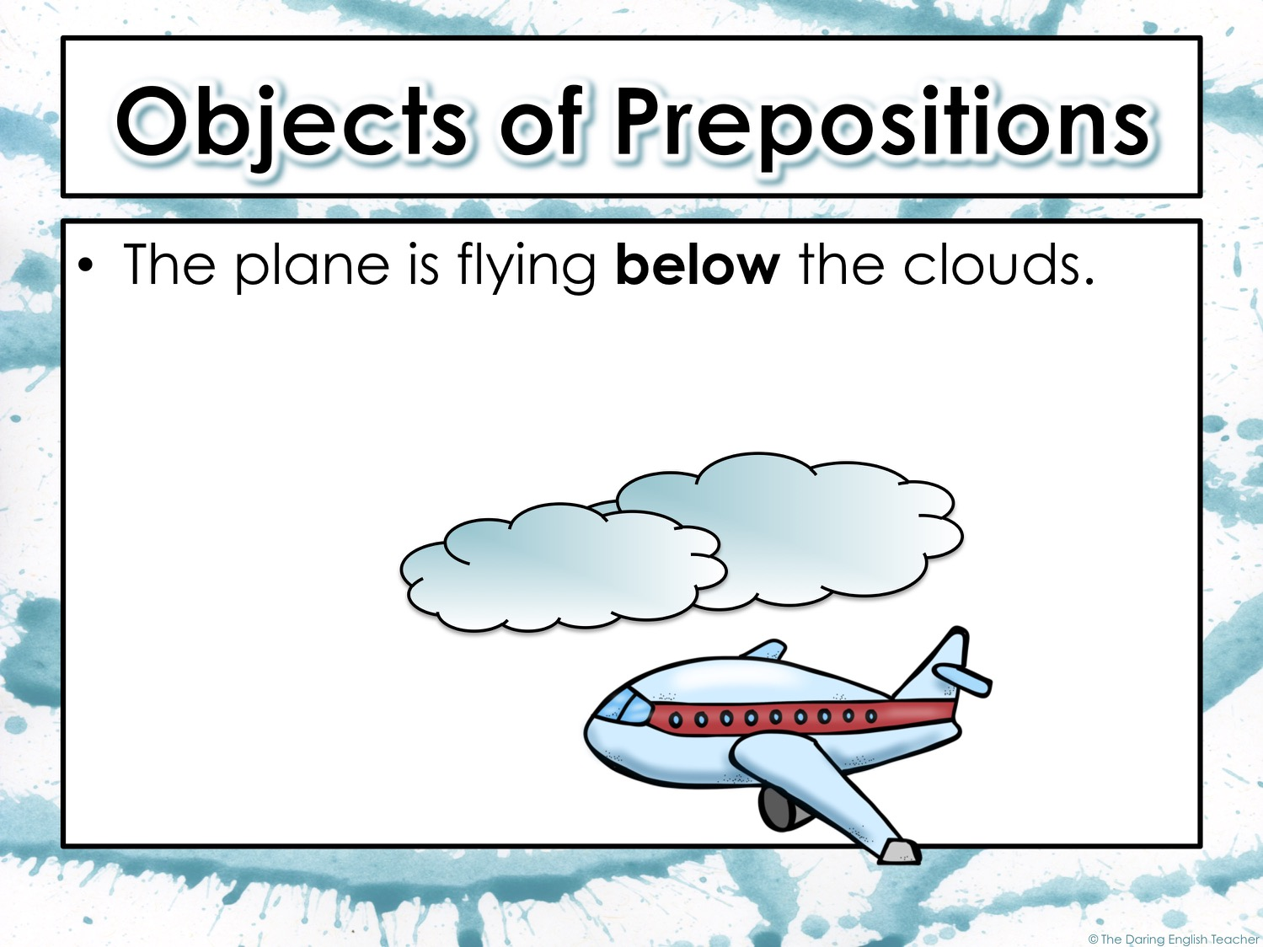
Below is the preposition. Clouds is the object.
below the clouds is the prepositional phrase

Slide 42
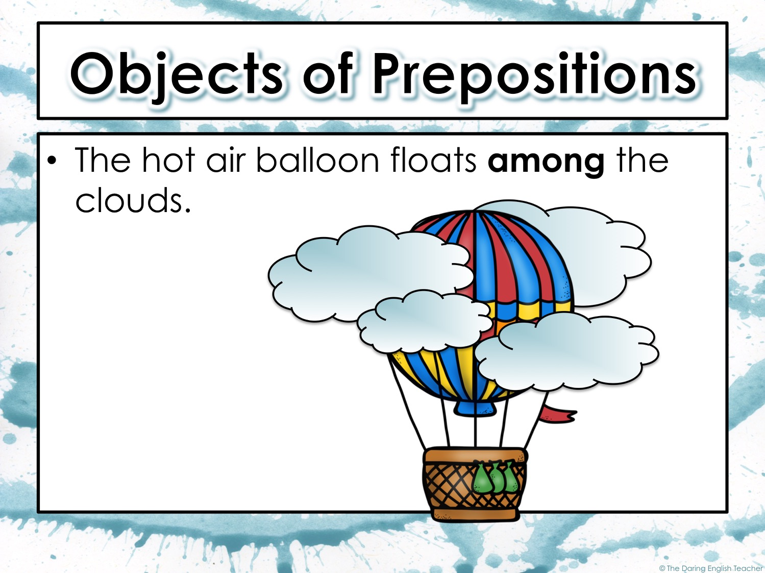
Among is the preposition. Clouds is the object.
among the clouds is the prepositional phrase

Slide 43
Prepositional Phrases
A prepositional phrase is a group of words that begins with a preposition and ends with its objects.
Examples:
over the hill
through the woods
around the corner
to the store
preposition
object

Slide 44
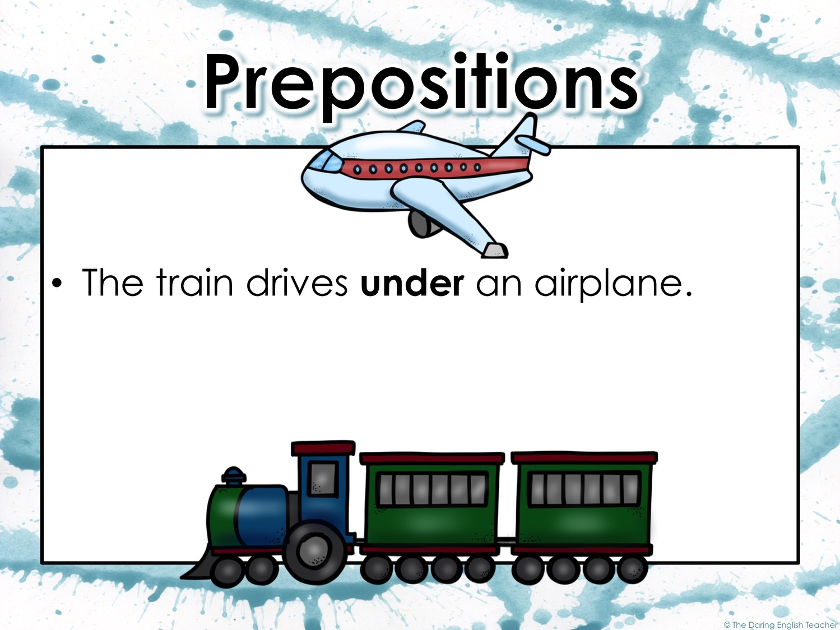
Under is the preposition. Airplane is the object.
under the airplane is the prepositional phrase

Slide 45
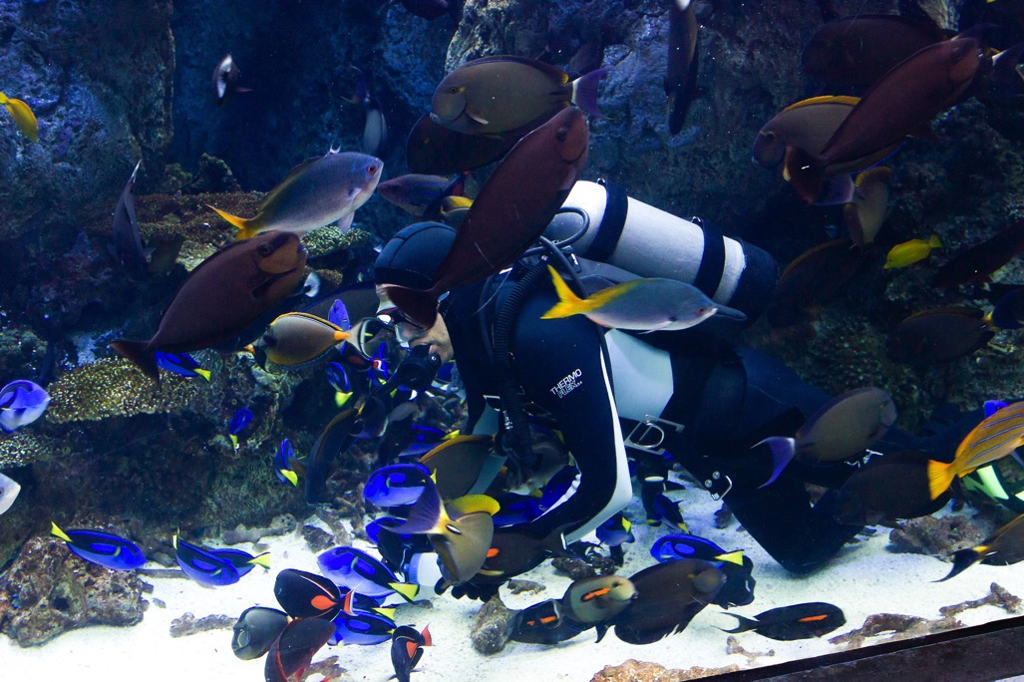
Prepositional Phrases
The diver swam in a large fish tank.

Slide 46

Prepositional Phrases
The praying mantis sat upon a leaf.

